Slide 1
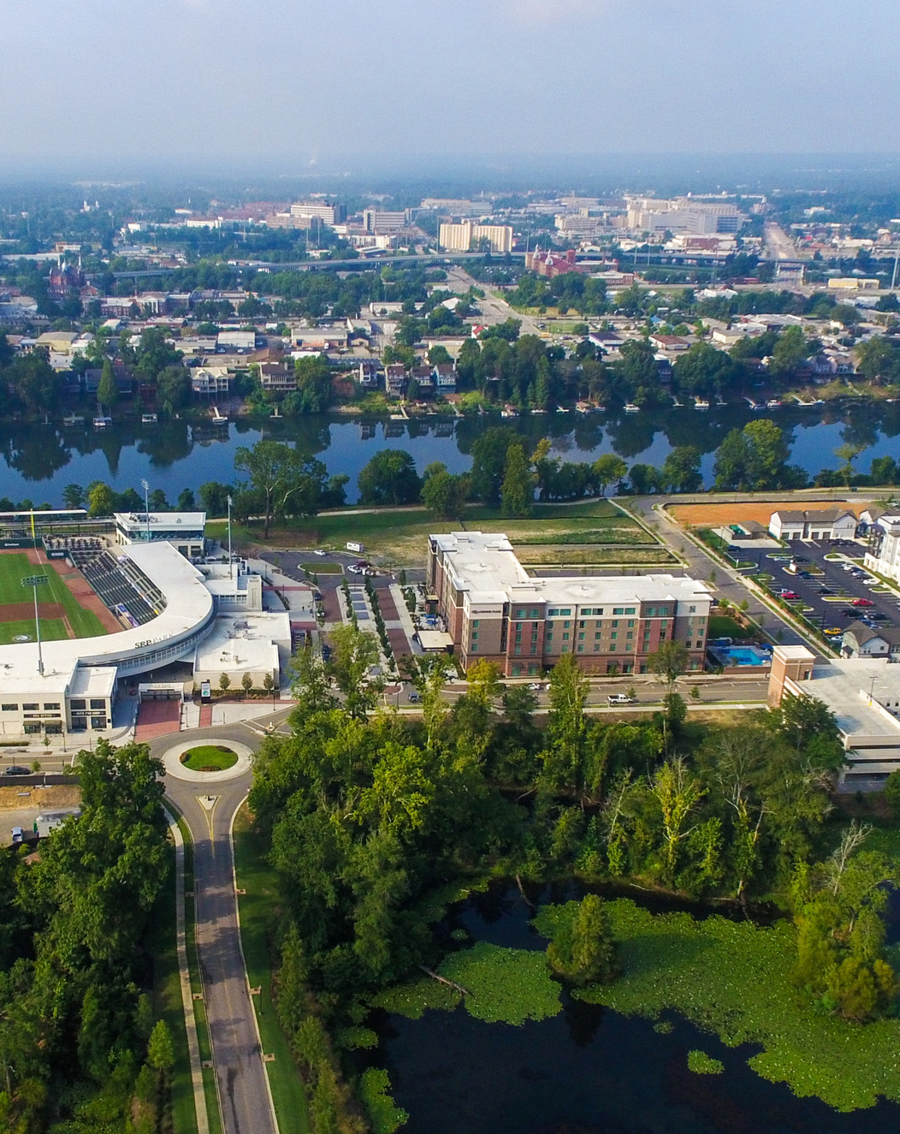
Newcommer’s Navigation of the North Augusta, SC Region
This is part of a larger Data Science Project which, in it’s initial roll-out explores North Augusta, SC based on Neighborhood Venues.
Presentation
Programming Notebook
Notes:
To change the image on this slide, select the picture and delete it. Then click the Pictures icon in the placeholder to insert your own image.

Slide 2
This Presentation Explores the Following
Geographic Exploration of North Augusta Counties
Identification of Popular Venues in Counties
Exploration of County Neighborhoods and Venues

Slide 3
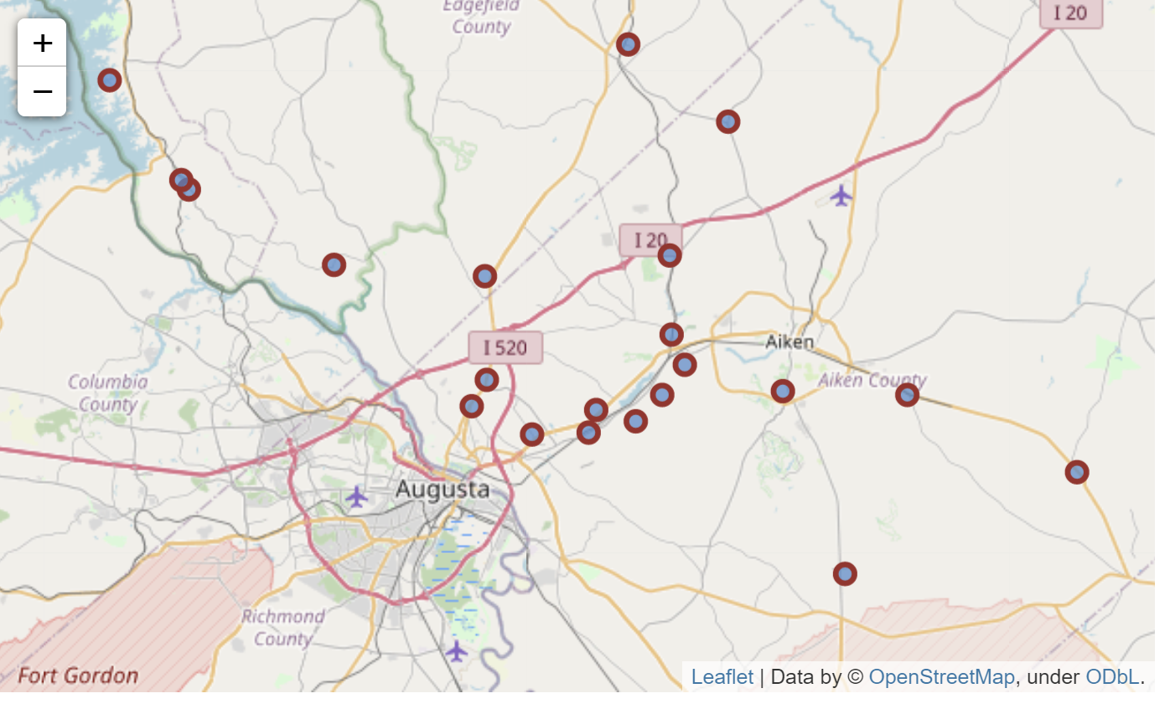
North Augusta’s Aiken and Edgefield Counties
Edgefield
Aiken

Slide 4
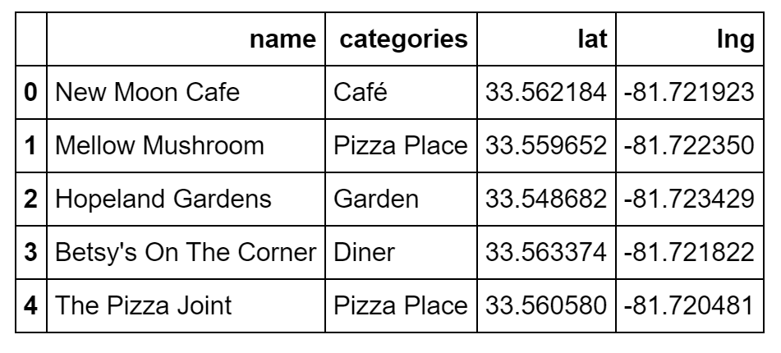
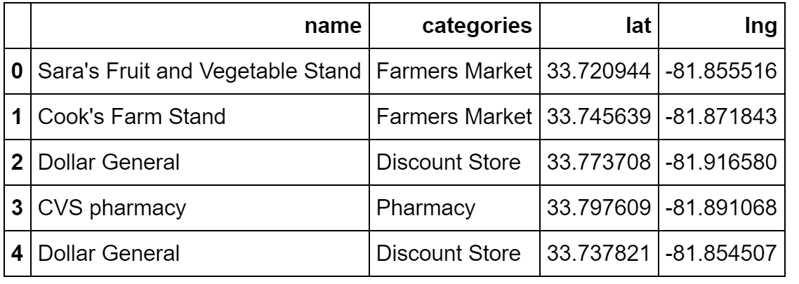
County Venues
Aiken
Edgefield

Slide 5
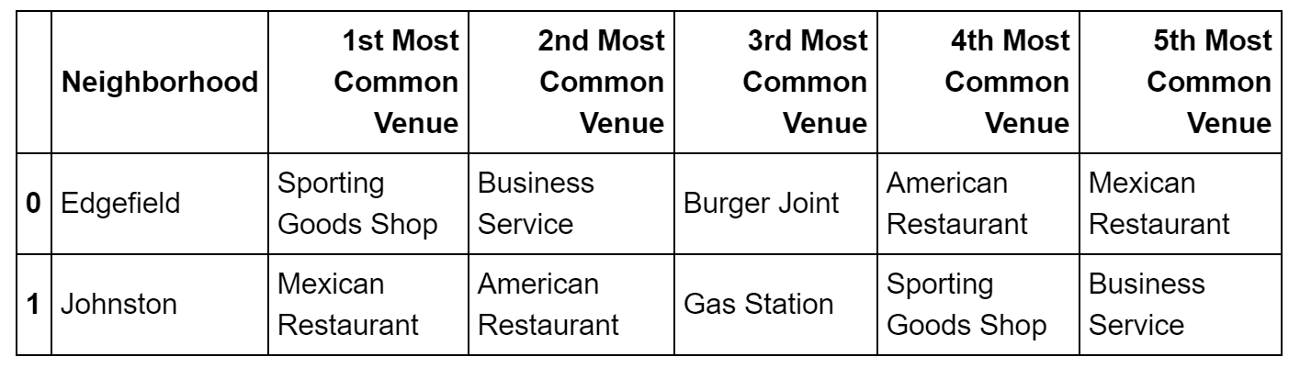
North Augusta County, Neighborhoods Explored
Edgefield

Slide 6
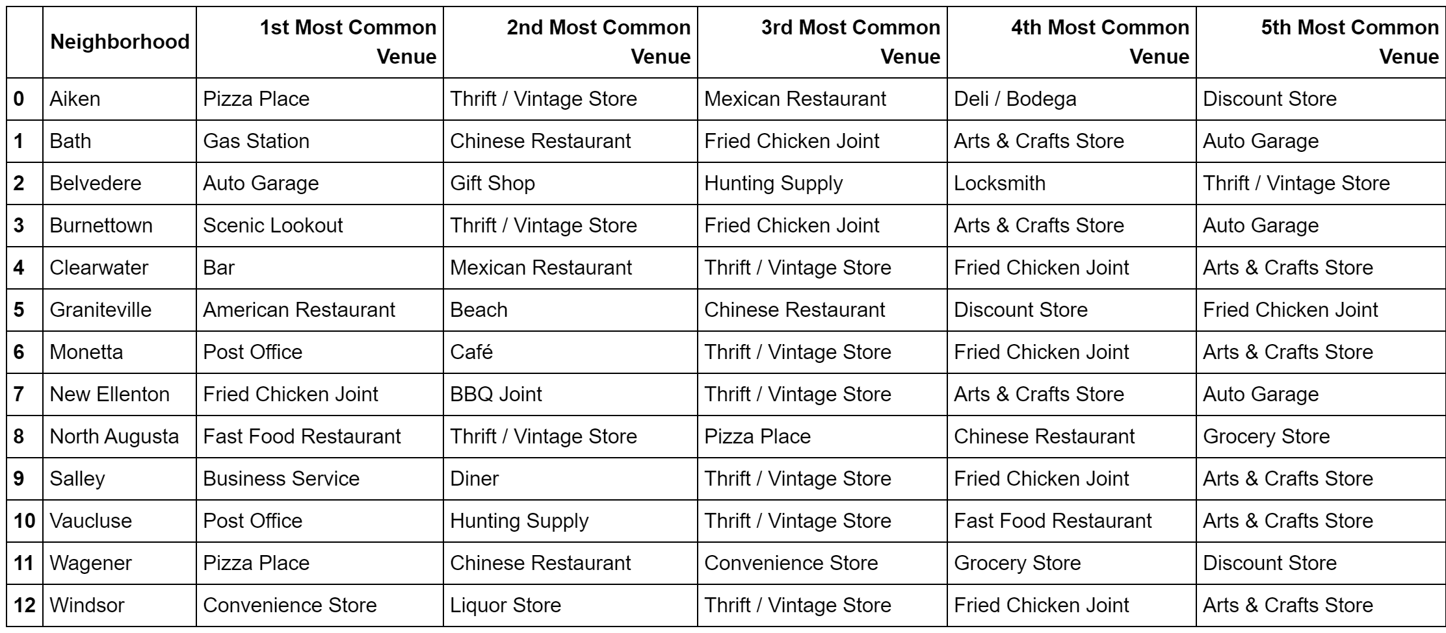
North Augusta County, Neighborhoods Explored
Aiken

Slide 7
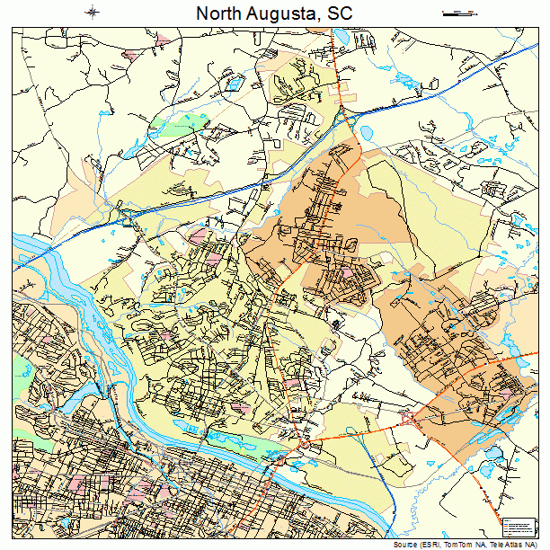
Summary
Without drawing conclusions, viewers can see how the city of North Augusta, associated Counties and Neighborhoods relate to a possible culture of that area.
This is meant to provide a tool, enabling users to approach the area without ever visting.
This is also the initial roll-out. Future versions are open to suggestions.

